Slide 1
Safe driving system
Team t:
Aparna a
Shiju np
Gishnu reghu

Slide 2
INTRODUCTION
Drinking and driving is a serious public vigor problem, which is likely to emerge as one of the most noteworthy problems in the near prospect.
Not only drunken drive, but also driving rudely without wearing seat belts in cars causes a lot of tragic lethal deaths.
The Alcohol Detection with Engine Locking system helps to reduce accidents which are occurring due to drunk driving.
Along with alcohol detection, system also checks whether the driver has worn the seatbelt or not. If it satisfies all the conditions, the vehicle will start.

Slide 3


Components used
Arduino UNO
MQ3 Sensor
Push button
DC Motor
Battery
Relay

Slide 4
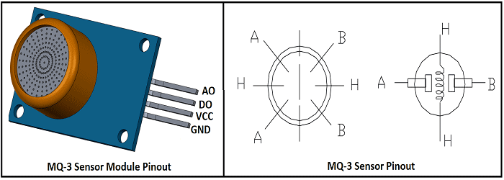
MQ3 SENSOR
It is a Metal Oxide Semiconductor (MOS) type of sensor.
Metal oxide sensors are also known as Chemiresistors, because sensing is based on the change of resistance of the sensing material when exposed to alcohol. So by placing it in a simple voltage divider network, alcohol concentrations can be detected.
The analog output voltage provided by the sensor (at AO pin) varies in proportion to the alcohol concentration. The higher the alcohol concentration in the air, the higher the output voltage.
It has mainly 4 pins: VCC,GND,Analog Out,Digital Out.

Slide 5
Block diagram
Arduino UNO
MQ3 Sensor
Push Button
Relay
DC Motor

Slide 6
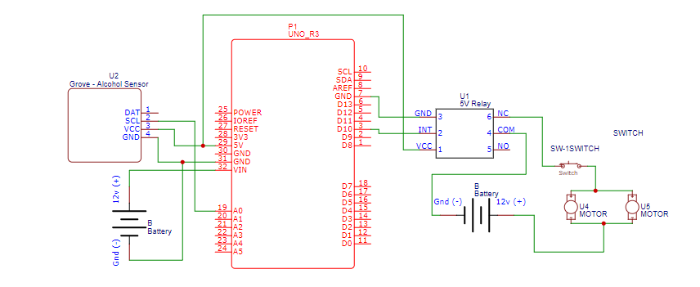
CIrcuit diagram

Slide 7
working
Initially,the system checks whether the driver has worn the seatbelt or not.
MQ-3 sensor detects the presence of alcohol in the surroundings.
The sensor provides output on the basis of the concentration of the alcohol, if the alcohol concentration is higher, the conductivity of MQ-3 sensor increases which in turn gives the reading to ARDUINO.
If the reading is greater than the threshold level, ARDUINO will stop the DC motor.Here DC Motor is used for representing engine locking.
If both conditions are satisfied,such that the seat belt is used and the alcohol is not used. Then the vehicle moves on without any problem.

Slide 8
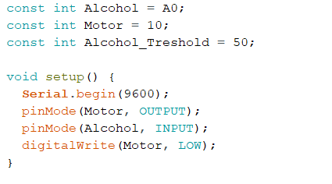
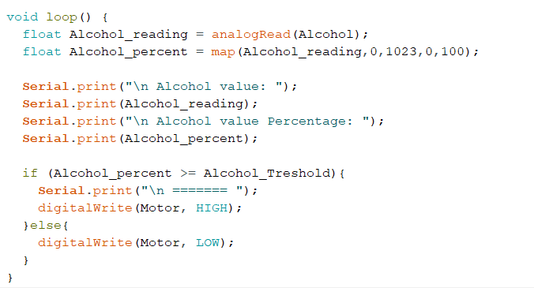
COde

Slide 9
COST
COMPONENTS | COST
Arduino UNO | 300
MQ3 Sensor | 132
DC Motor | 80
Battery | 20
Relay | 125
Push Button | 20
Breadboard | 80
Jumper wires | 30
Total | 787

Slide 10
CONCLUSION
We have given an incredibly capable way to deal and to develop a smart system for vehicles to diminish number of disasters caused in light of alcoholic driving.
Safe driving system can be implemented in any four wheelers, and it helps to prevent accidents due to drunk driving.
This system improves the security of individual and in this manner giving the convincing progression in the vehicle business regarding decrease setbacks caused in light of driving.

Slide 11


Thank you

